Slide 1

Real-Time Traffic Analytics
Using Azure Stream Analytics
Mariam Zakria - Gehad Helmy - Amr Khaled - youssef Abdelrahman
Data Engineers

Slide 2


Project Idea
Our project focuses on simulating traffic data and utilizing Azure services for real-time analytics, enabling effective monitoring and alerting in smart city environments.

Slide 3



Team Members
Roles and Contributions in the Project
Our team consists of diverse professionals: Mariam focuses on simulation, Gehad handles data ingestion, Amr manages real-time analytics, and Youssef provides crucial support throughout Notifications and alerts.

Slide 4

Simulation & Ingestion
Understanding the Initial Data Flow Process
In this milestone, we simulate traffic data using Python, which is then ingested into Azure Event Hub for real-time processing. This sets the foundation for our analytics.

Slide 5

Milestone 1 Deliverables
Event Hub Setup
SAS Policy
SDK Setup
Configure Azure Event Hub to receive streaming traffic data.
Establish secure access with Shared Access Signature for authorization.
Integrate Azure SDK for seamless event publishing and processing.
Real-Time Validation
Data Ingestion
Monitoring Events
Ensure validated events are correctly processed and logged in Azure.
Stream simulated traffic data into Event Hub for analysis.
Implement monitoring tools to track data flow and detect issues.

Slide 6


Real-Time Processing
Analyzing Traffic Data Instantaneously
Azure Stream Analytics enables real-time processing of traffic data, allowing for immediate anomaly detection and insights. This enhances decision-making and response strategies in smart traffic management systems.

Slide 7

Detection Logic
Congestion
Identified when traffic volume exceeds 25 vehicles.
Overview of traffic anomaly detection rules
High Speed
Detected when speed readings exceed 100 km/h.
Accident
Noted if speed drops below 40 km/h during bad weather.
Real-Time Insights
Generated to enhance traffic management and safety.

Slide 8

Milestone 2 Outputs
Power BI Dataset
Data Lake Gen2
Validated Events
The dataset provides real-time visualizations for traffic insights and trends.
This storage solution handles large volumes of traffic data efficiently.
Events are confirmed and ready for further analysis and processing.
Real-Time Monitoring
Historical Data
Continuous tracking of traffic health and anomaly detection occurs seamlessly.
Historical insights are stored for trend analysis and future modeling.

Slide 9
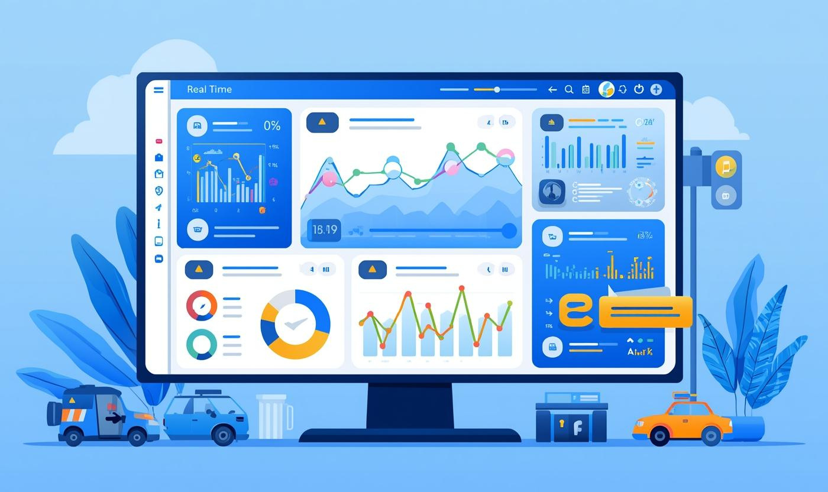

Dashboard & Alerting
This milestone focuses on the visualization of traffic data through interactive dashboards, providing instant insights and alerts to enhance decision-making for urban traffic management.

Slide 10
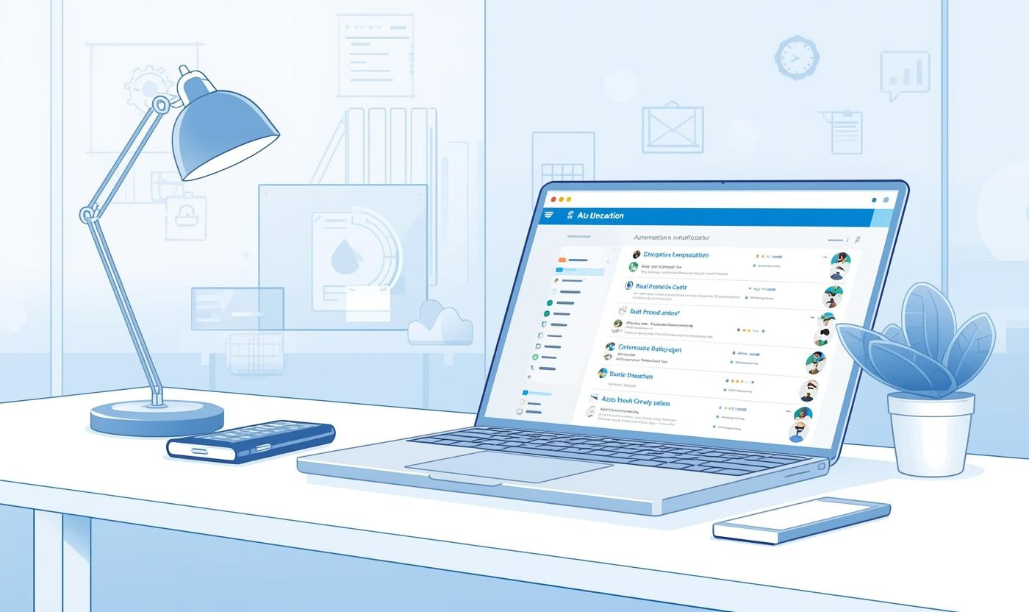

Automated Email Alerts
Efficient notification system for critical alerts
The Automated Email Alert System enhances real-time traffic management by sending critical notifications through email, ensuring timely responses to congestion, accidents, and other anomalies detected in traffic data.

Slide 11
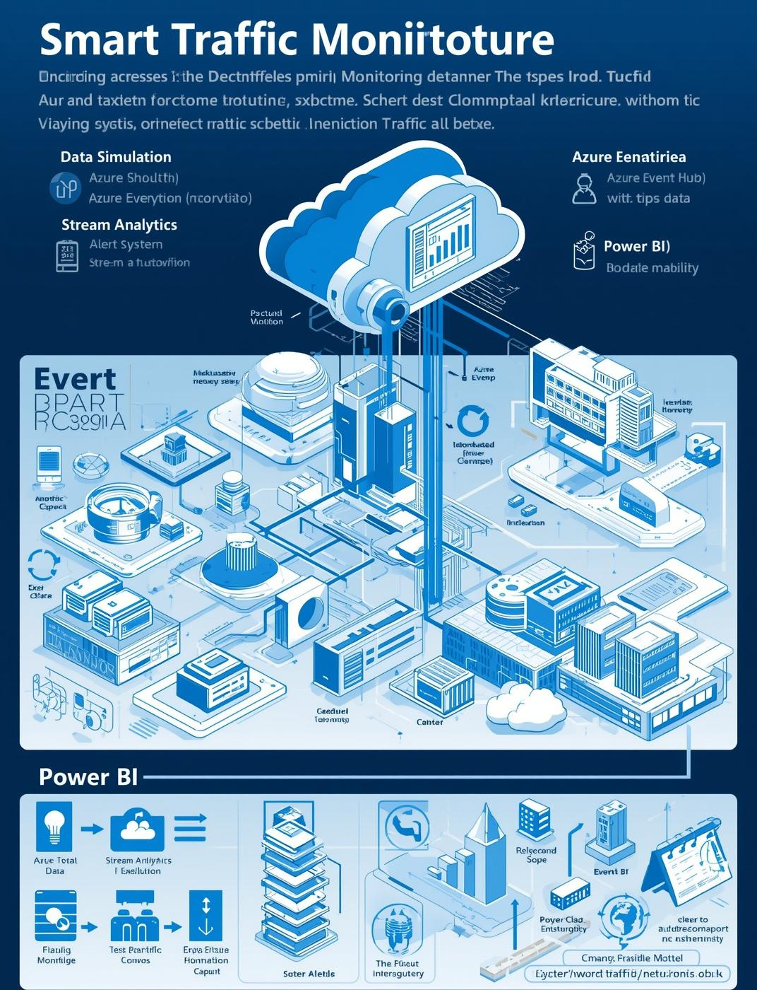
System Architecture
This architecture diagram provides a comprehensive view of our end-to-end traffic analytics system, illustrating data flow from simulation to real-time analytics and alerting mechanisms.

Slide 12

Future Development Ideas
Integrating with MOVES
Supporting Egypt’s Vision
Mobile App
Real-time traffic → instant emissions (CO₂, NOx, PM2.5)
Identify pollution hotspots & reduce congestion
Build emissions database
Enable smart-city & green transport planning
Developing a mobile app for user engagement and live traffic updates.
COP27 Alignment
Smart Scaling
Community Outreach
Promote sustainable cities & eco-mobility
Provide live data for climate decisions
Scaling the system to support smart cities and integrated urban planning.
Fostering community engagement to raise awareness about traffic safety and analytics.

Slide 13
Thank You
We appreciate your attention and interest in our project on real-time traffic analytics. Please feel free to ask any questions or share your thoughts!

